Slide 1


Credit One Data Science Project
Ana Victoria Granera

Slide 2
Background
Credit One is a credit bureau who has detected an issue with a number of customers who have defaulted on loans, and the want to solve the problem right away.
Scope
Understand how much credit to allow someone to use, or at least, if someone should be approved or not by using data science analysis methods.
Approach
Have a Data Science team to design and implement a creative solution.

Slide 3
Data Insights
The data set provides insights from customer default payments data and demographics. It is located in a repository provided by Credit One.
Demographics: Sex, education, marital status and age.
Account balance limit.
History of past payments divided by months.
Amount of Bill statement ($$$) divided by months.
Amount of previous payment ($$$) divided by months.
Client’s behavior (default or not default payment).

Slide 4
Data Insights
The data will be managed using Python libraries, Jupyter, a Github repository. I basic knowledge on MySQL is needed too.
A set of linear regression methods, along with Machine Learning
What are the challenges of the data set?
The data quality is not the best. History of past payments, amount of bill statement and amount of payment statements columns offer a lot of messy data.
The column types are all objects (string), we need to change the type to integer or float, depending of the nature of the data and what is needed for the methods we want to use.

Slide 5
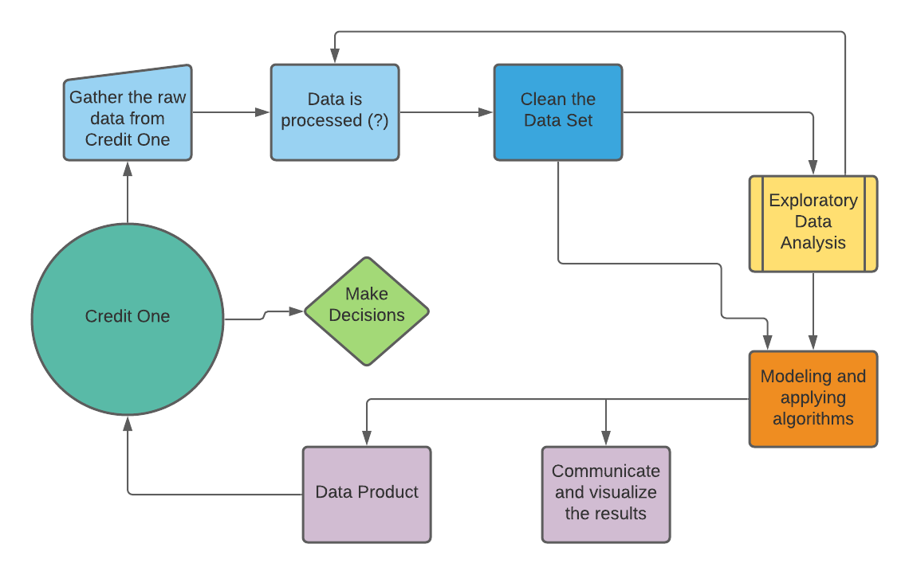
Data Process Flowchart

